Slide 1

KOHONEN SELF ORGANIZING MAPS
The main property of a neural network is an ability to learn from its environment, and to improve its performance through learning.
So far we have considered supervised or active learning − learning with an external “teacher” or a supervisor who presents a training set to the network. But another type of learning also exists: unsupervised learning.

Slide 2
KOHONEN SELF ORGANIZING MAPS
In contrast to supervised learning, unsupervised or self-organised learning does not require an external teacher. During the training session, the neural network receives a number of different input patterns, discovers significant features in these patterns and learns how to classify input data into appropriate categories. Unsupervised learning tends to follow the neuro-biological organisation of the brain.
Unsupervised learning algorithms aim to learn rapidly and can be used in real-time.

Slide 3
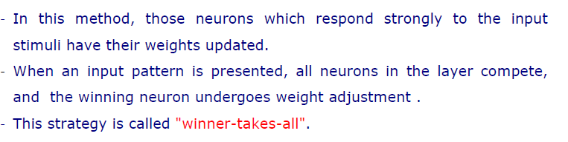
Compititive Learning

Slide 4
KOHONEN SELF ORGANIZING MAPS
Architecture
neuron i
Kohonen layer
w_{i}
Winning neuron
Input vector X
X=[x₁,x₂,…x_{n}] ∈ R^{n}
w_{i}=[w_{i1},w_{i2},…,w_{in}] ∈ R^{n}

Slide 5
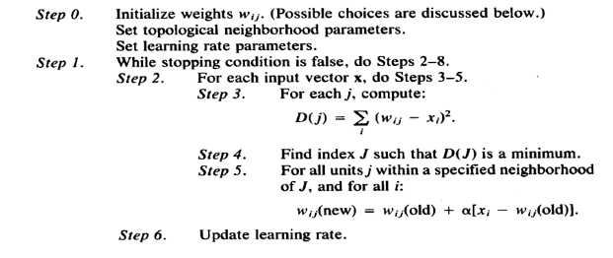

SOM Algorithm

